Slide 1

Infancy, Childhood, and Adolescence

Slide 2
Write About It
How have you changed since you were a young child, and how have you stayed the same?

Slide 3
Learning Targets
Identify major developmental milestones in infants and young children.
Describe puberty, and list the secondary sex characteristics of males and females.
Identify two cognitive changes that occur during adolescence.
Describe two emotional changes and their impacts that occur during adolescence.
Notes:
The nervous systems has two main parts: the central nervous system and the peripheral nervous system.

Slide 4
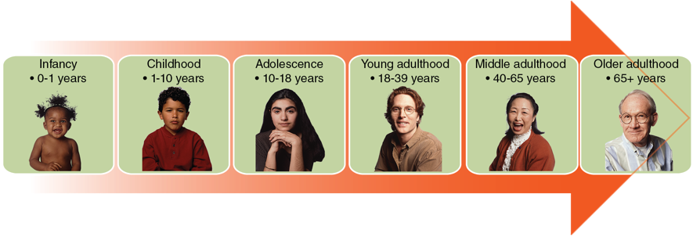
How Long Do We Live?
The average lifespan in the United States is 80 years for females and 75 years for males.
There are six basic developmental phases of the lifespan:
Notes:
The skin is the most important component of the integumentary systems and consists of three layers: the epidermis, dermis, and subcutaneous.

Slide 5
Areas of Human Development
Physical
  Growth such as height and weight, motor (movement) skills, and sensory perceptions
Cognitive
  Language use, problem-solving, reasoning
Socioemotional
  Emotional awareness and expression, relating to others
Notes:
The excretory system involves the work of the kidneys, bladder, urethra, and skin.

Slide 6
Developmental Milestones for Infants and Young Children (1 of 2)
Age | Milestones
0-6 months | Grows rapidly (doubles birth weight), follows objects with eyes, reaches with both hands, places objects in mouth, turns over unassisted, recognizes parents with smile at 2 to 3 months, responds to adult interaction by 6 months.
7-12 months | Triples birth weight, doubles birth length, begins to grow teeth, stands up, crawls and begins to walk unassisted, begins to distinguish strangers, experiments with sounds, develops sense of self, distinguishes between good and bad, begins to attract attention with giggles and shouting, has sense of humor, demonstrates separation anxiety from parents.
(continued)
Notes:
The immune system is a complex network consisting of your tonsils, lymph nodes, lymphatic vessels, spleen, thymus, appendix, and bone marrow.

Slide 7
Developmental Milestones for Infants and Young Children (2 of 2)
Age | Milestones
1-3 years | Continues to grow and gain weight (at a slower rate), has emerging teeth, runs, climbs, pushes and pulls, can learn taught skills, has fully developed range of emotions, moves from playing alone to having a set of friends, understands friendship, uses short sentences such as “me want cookie.”
4-6 years | Continues to grow 2 to 3 inches (5 to 7.5 cm) per year; legs lengthen; eats and drinks independently; hops, skips, and throws; has emerging molars and some permanent teeth; generally wants to please others; can follow rules and play in groups; selects own friends; uses a vocabulary of 2,100 words.
Notes:
The immune system is a complex network consisting of your tonsils, lymph nodes, lymphatic vessels, spleen, thymus, appendix, and bone marrow.

Slide 8
Adolescence (1 of 2)
Transition from childhood to adulthood
Ages 10–19
Marked by puberty
  Development of secondary sex characteristics and reproductive ability
Growth spurts
Cognitive changes to abstract thinking and reasoning
Issues with impulse control
Intensive self-discovery and searching
(continued)
Notes:
The nervous systems has two main parts: the central nervous system and the peripheral nervous system.

Slide 9
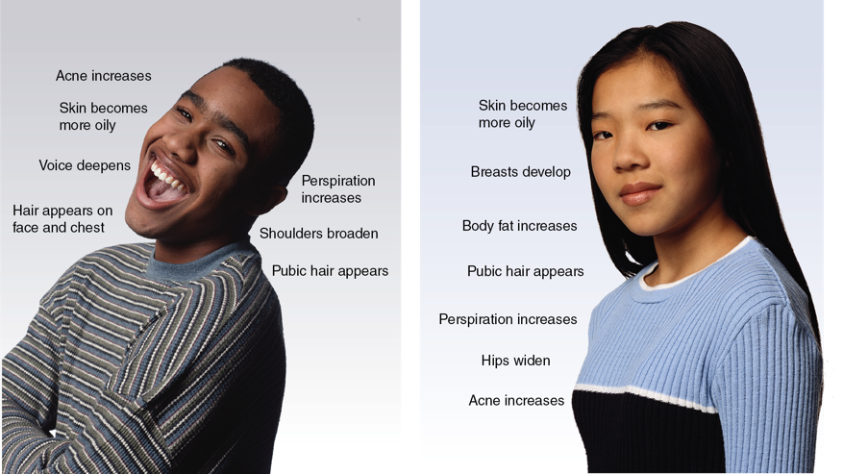
Adolescence (2 of 2)
Notes:
The nervous systems has two main parts: the central nervous system and the peripheral nervous system.

